Slide 1
Machine Learning Project on Regression: Order Delivery Time Prediction
Group members:
Ajitesh Chauhan
Rishi Dave
Shefali Kolge

Slide 2
Introduction
This is a Brazilian e-commerce public dataset of orders made at Olist Store, largest department store in Brazilian marketplaces.
The dataset has information of 100k orders from 2016 to 2018 made at multiple marketplaces in Brazil.
Its features allows viewing an order from multiple dimensions: from order status, price, payment and freight performance to customer location, product attributes, order details like order approved timestamp, estimated delivery date, delivered date and finally reviews written by customers.

Slide 3
Objective
The goal of this project is to predict the number of days required for an order to be delivered to a customer.
The idea is to improve the customer experience.
Predicting actual delivery days taken to deliver an order will help improve the timeline that the company gives for estimated delivery days.
This in turn will help the company to provide precise estimated delivery days, which will help the customers to have proper knowledge the delivery date of their orders.

Slide 4
Design
Business Understanding
Data Understanding
Data Preparation
Model Building
Evaluation
Insights

Slide 5
Business Understanding
This dataset was generously provided by Olist, the largest department store in Brazilian marketplaces.
Olist connects small businesses from all over Brazil to channels without hassle and with a single contract.
Those merchants are able to sell their products through the Olist Store and ship them directly to the customers using Olist logistics partners.
Website: www.olist.com

Slide 6

Data Understanding
Data Schema: The data is divided in multiple datasets for better understanding and organization.

Slide 7
order_status: Reference to the order status (delivered, shipped, etc)
price: item price
freight_value: item freight value item (if an order has more than one item the freight value is split between items)
order_purchase_timestamp: Shows the purchase timestamp.
order_approved_at: Shows the payment approval timestamp.
order_delivered_customer_date: Shows the actual order delivered date
order_estimated_delivery_date: Shows the estimated delivery date that was informed to customer at the purchase moment.
customer_state: customer state
product_category_name: category of product
product_name_length: number of characters extracted from the product name.
product_description_length: number of characters extracted from the product description.
product_photos_qty: number of product published photos
review_score: ranging from 1 to 5 given by the customer on a satisfaction survey.

Slide 8
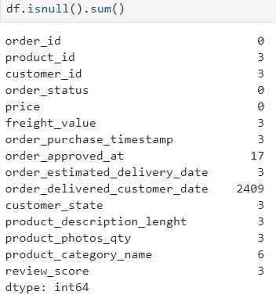
Workflow
Checking NA values:
Checking whether any dates fall on Brazil Public holidays
Creating target variable: Delivery time in days
Checking unique values in all features
Removing the features that will not be useful
Checking correlation
Checking skewness of data
Performing Log Transformations
Checking and removing outliers
Feature Engineering
Taking antilog for actual values of delivery time in number of days

Slide 9
Data Preparation
Dropped features that were not related to our target variable like reviews related features.
Removing NA values
Creating our target variable: Delivery time in days
Also created estimated delivery time in days
Checking whether the dates are not falling on any Public holidays in Brazil
Dropping other datetime features

Slide 10
Exploratory Data Analysis

Slide 11
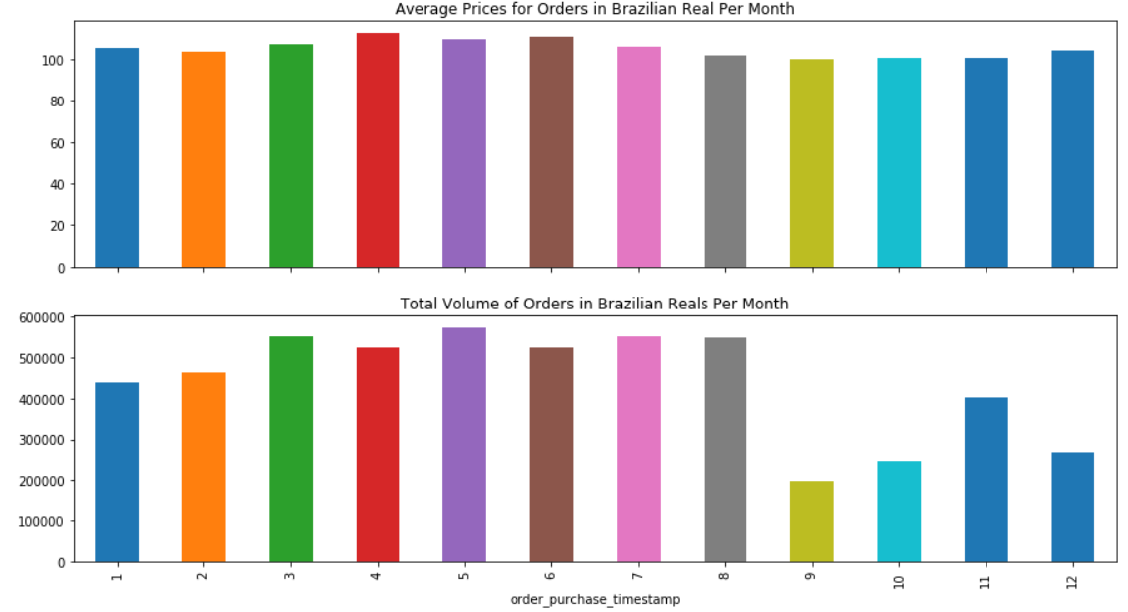

Slide 12
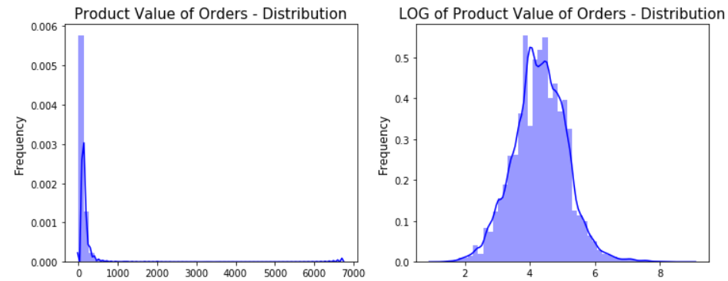
Skewness Plot

Slide 13
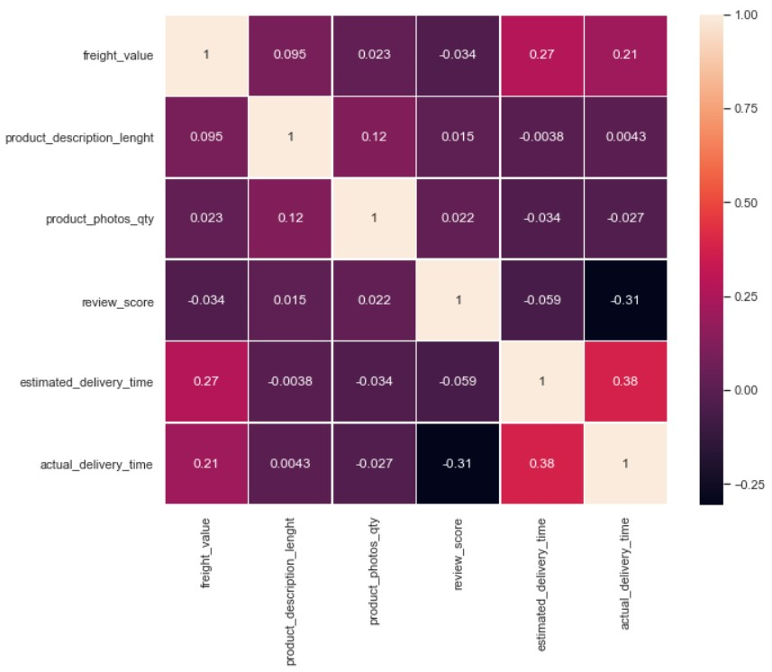
Correlation heatmap

Slide 14
Evaluation Metric
Dataset Type | Course of Action | R2 Score | RMSE
Test Data | Applying Linear Regression without any transformations | 0.28 | 8.048
 | Log Transformations | 0.405 | 0.506
 | After Removing Outliers | 0.4834 | 0.411
Train | Applying Linear Regression without any transformations |  | 7.81
 | Log Transformations |  | 0.504
 | After Removing Outliers |  | 0.413

Slide 15
Thank You

